Slide 1
Cardio Good Fitness Case Study
Ian Hanes
UT DSBA PGP - 2021

Slide 2
Background/Objectives
Cardio Good Fitness is a store that sells running equipment, most notably several models of treadmills
We have been asked to develop a customer profile for the different products, analyze the provided dataset, and generate some recommendations to assist in targeting new customers

Slide 3
Data Summary
The data contains the following demographic information:
Variable | Description
Product | Model no. of treadmill
Age | Number of years old per customer
Gender | Male or Female
Education | Number of years of schooling
Marital Status | Single or partnered
Usage | Number of times the customer will use the treadmill each week
Fitness | Fitness self score from 1 - 5
Income | Yearly income of customer
Miles | Expected to run
Observations | Variables
180 | 9

Slide 4
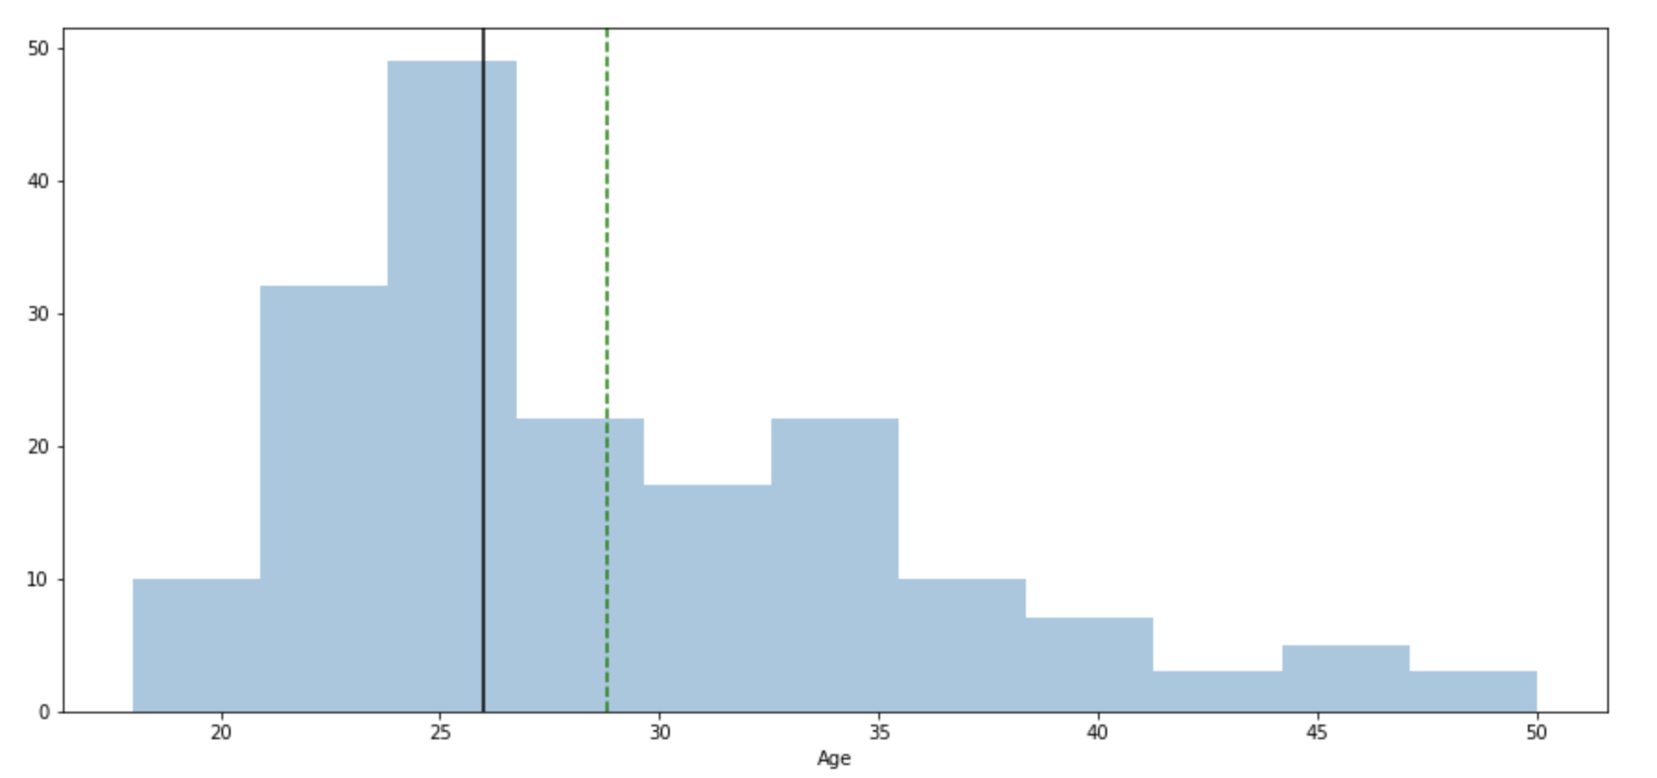
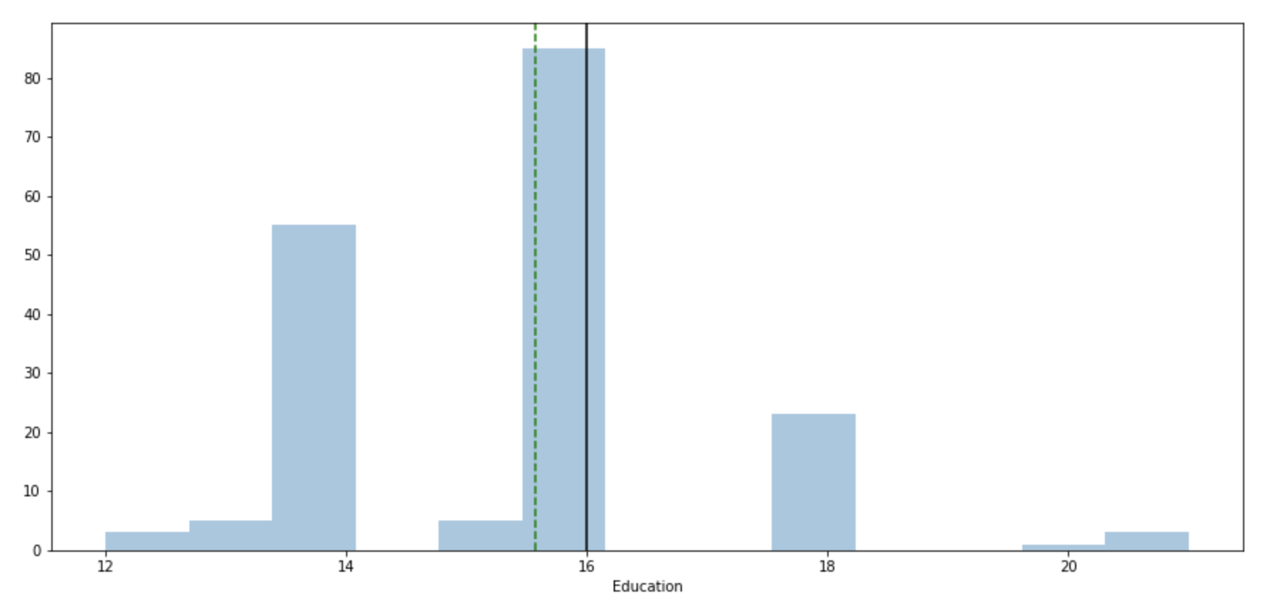
Exploratory Data Analysis – Age/Education
In order to build out a customer profile, let’s examine some basic variables, starting with Age and Education
Observations:
In general, customers are young adults (18-33) with at least some level of college education
Distribution of age is right skewed
Despite a mostly younger clientele, there are users as old as 50
Similarly, there is a non-trivial amount of masters/PhD holders as customers

Slide 5
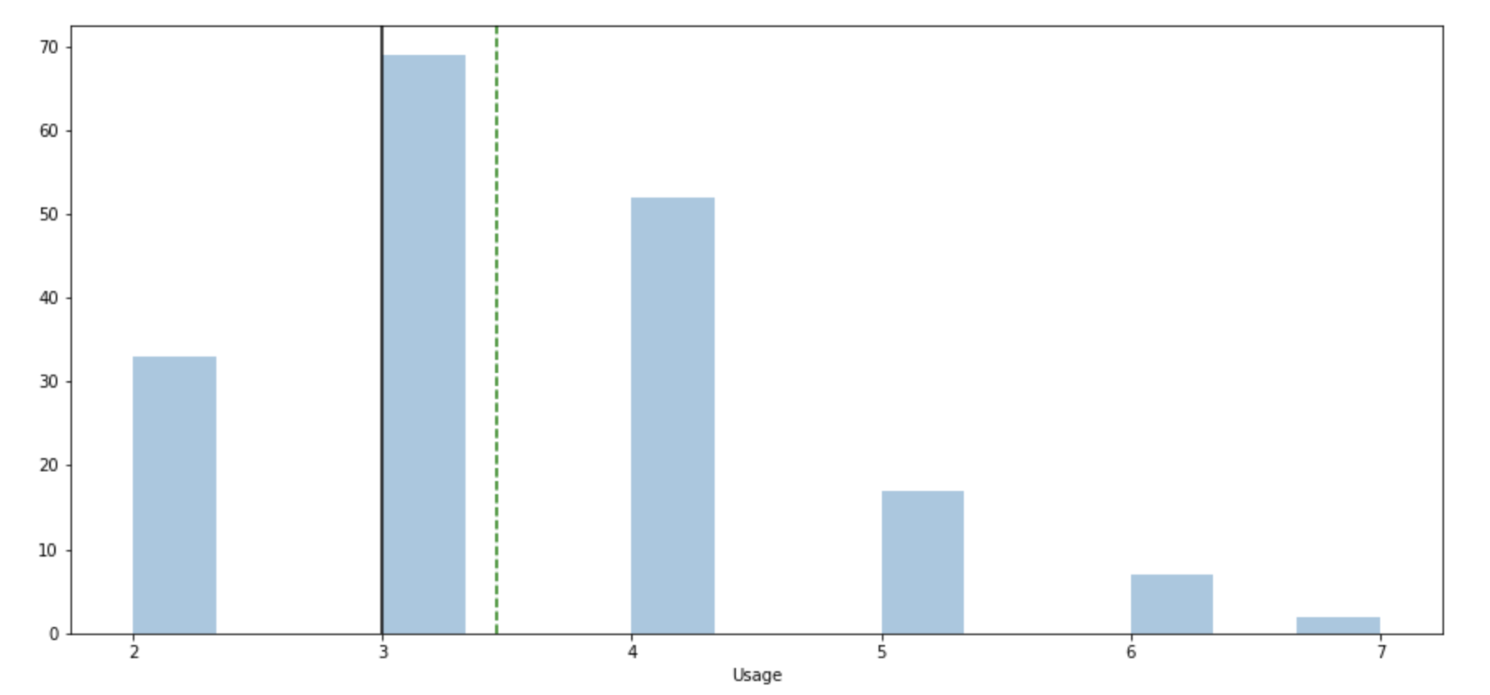
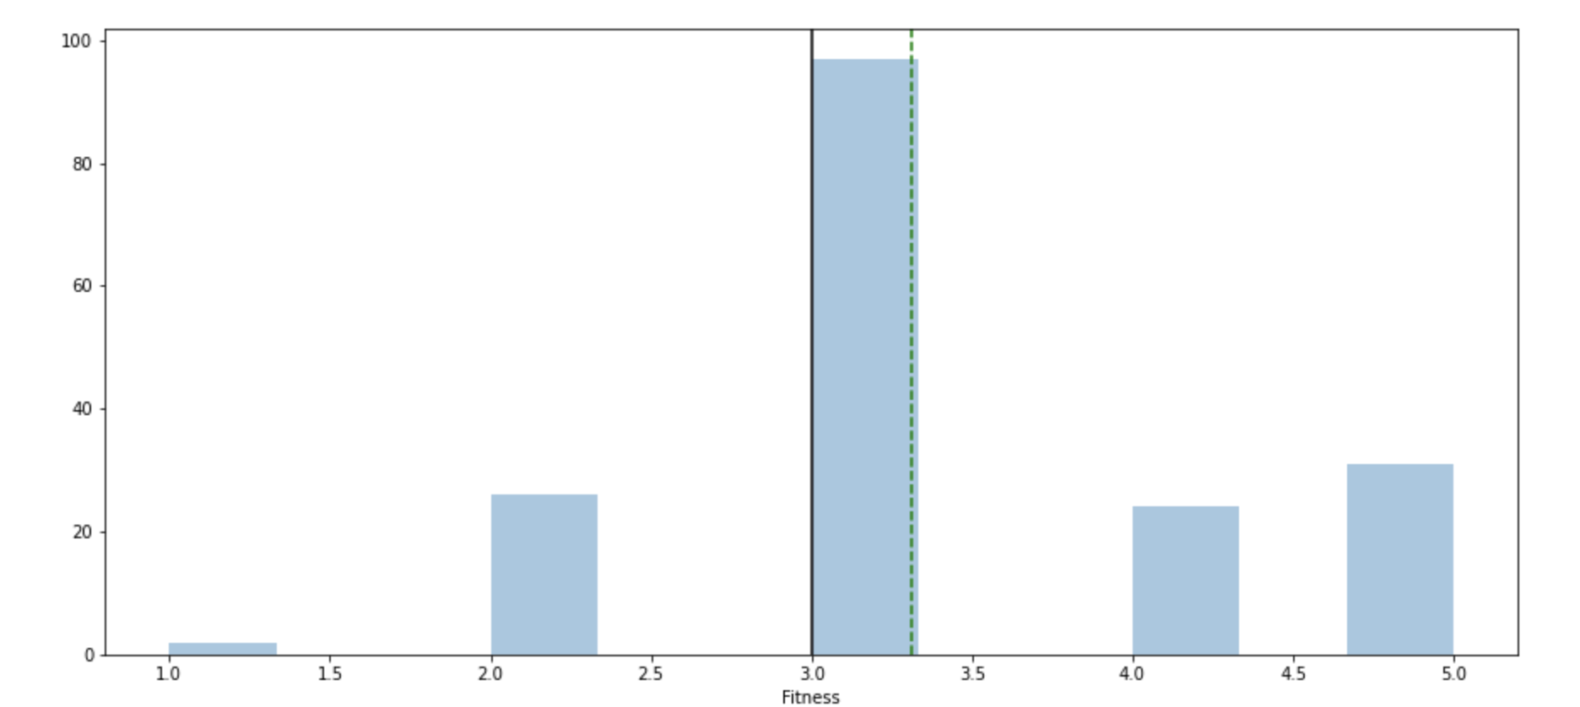
Exploratory Data Analysis – Usage/Fitness
Continuing from the previous slide, let’s now examine usage and fitness levels
Observations:
The vast majority of customers use their treadmills at least 3 times per week
A similar majority rated themselves as 3 or higher on a fitness scale from 1 - 5
The average usage is 3x per week with a median of 3.5
The average fitness level is 3 with a median of about 3.4
Based on this, we can assume that the average customer is also already in good shape and a moderate or above user

Slide 6
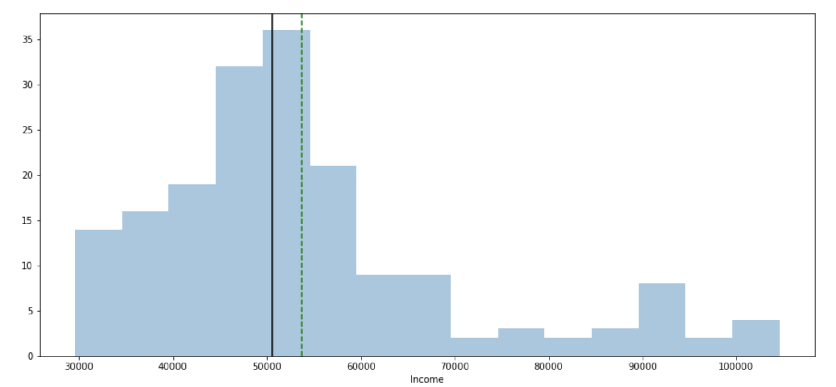
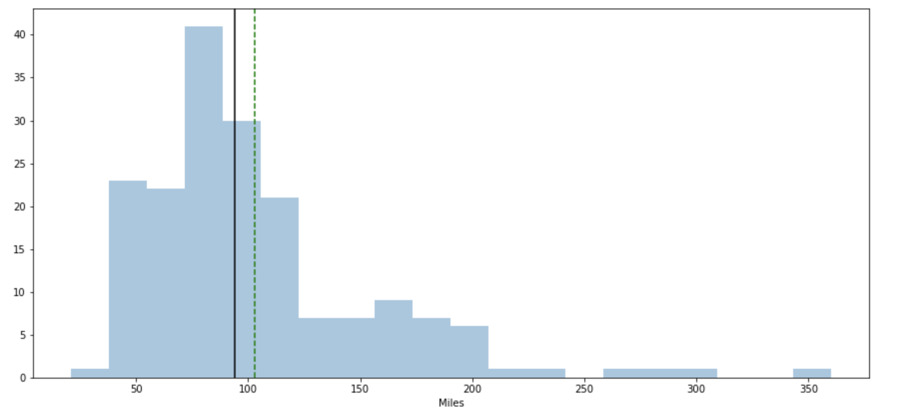
Exploratory Data Analysis – Income/Miles
Continuing from the previous slide, let’s now examine income and miles
Observations:
The median income is about $52,000, but there is a considerable range of incomes
Similarly the median mileage is around 100, but a wide range of mileages exists
This suggests that while the products are most popular with intermediate level runners, there is viability for more advanced athletes
Additionally, there is a baseline interest from higher earners that may not be capitalized on

Slide 7
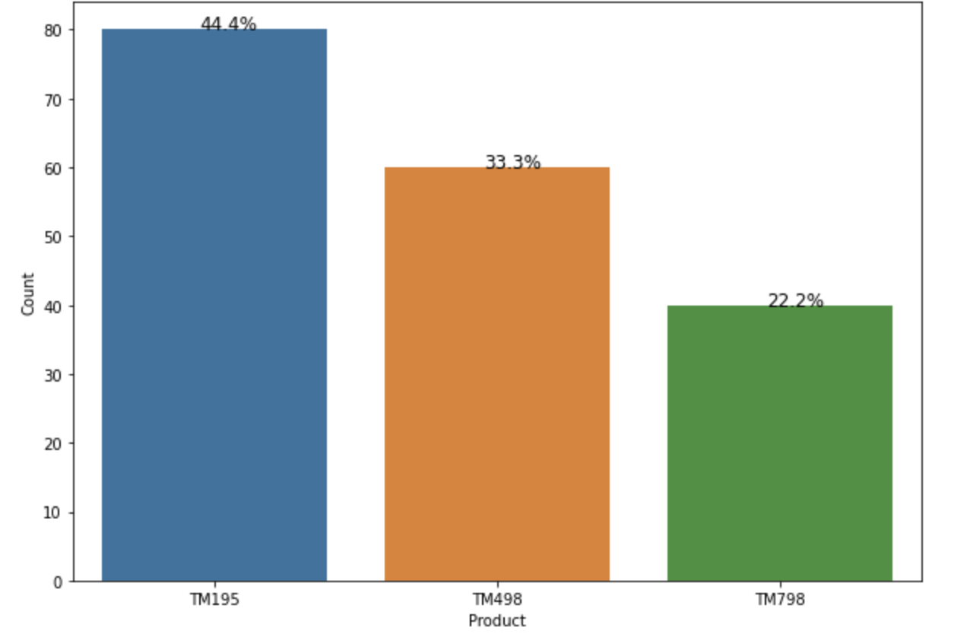
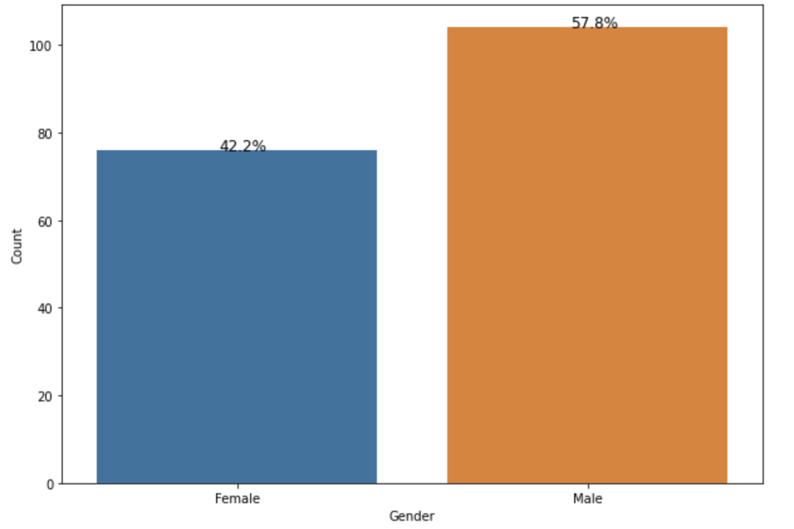
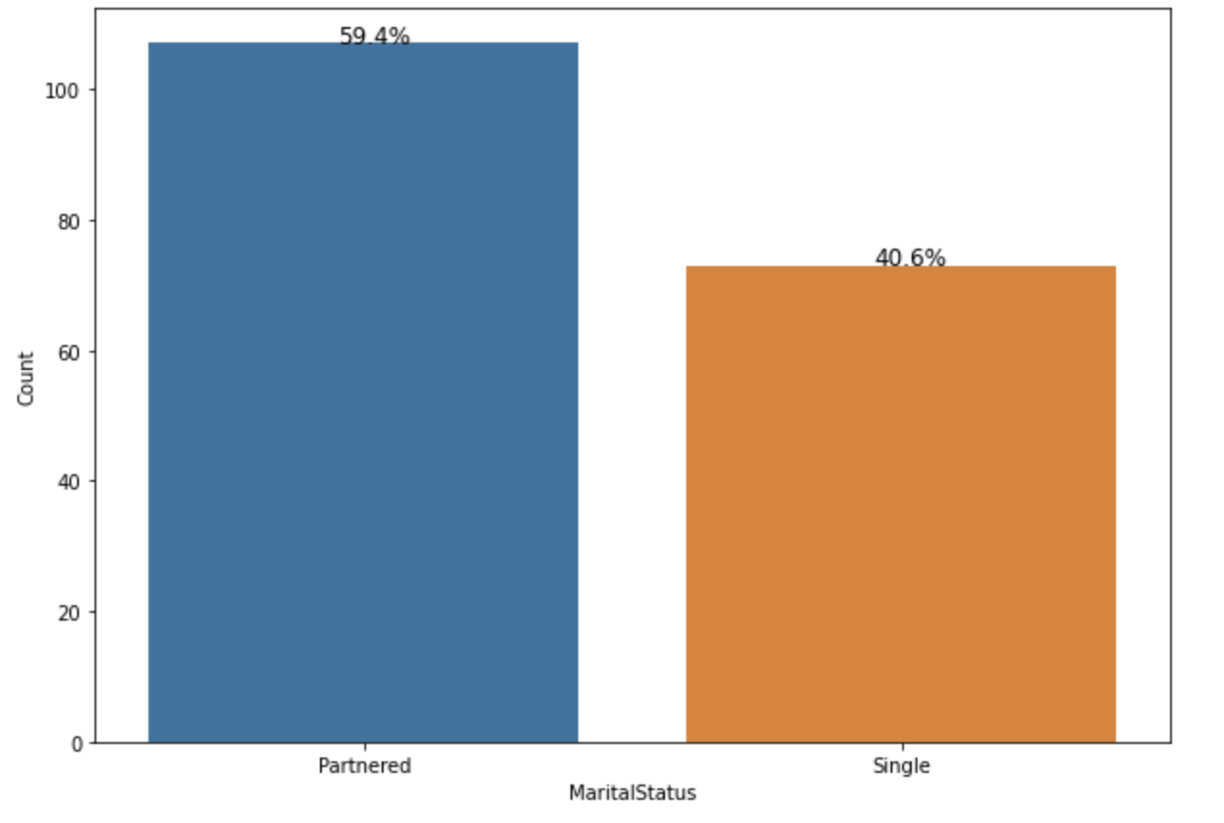
Exploratory Data Analysis – Product/Gender/Marital Status
Continuing from the previous slide, let’s now examine income and miles
Observations:
The TM195 is the best seller with the TM489 and TM789 decreasing by 11.1% and 22.2%
A slight majority of customers are men
A slight majority of customers are married

